Slide 1
Text and Audio Classification Enabled Diagnosis for Treatment Applications by Natural Language Processing (NLP) and Deep Learning (DL)
HAMEEM M MAHDI
National University, School of Technology and Engineering
Dissertation Chair: Dr. Nabeel
Subject Matter Expert: Dr. Tsapara
Academic reader: Dr. Al-Najada
Notes:
Good afternoon, doctors.
I am Hameem, a Senior Cloud Integrations Engineer at the Mayo Clinic, the world's number one hospital. I’ve been in the information technology field for over twenty years.
Today, I will discuss how "Text and Audio Classification Enabled Diagnosis for Treatment Applications by Natural Language Processing (NLP) and Deep Learning (DL)“ can help doctors diagnose patients better. My presentation shows how NLP and DL can understand patient text notes and voice recordings to improve medical treatment. This technology will help doctors work more efficiently and provide better patient care.

Slide 2
INTRODUCTION
Healthcare settings face challenges in investigating textual and auditory data
Current diagnosis systems rely heavily on human interpretation
Paper-based procedures dominate data capture systems
Technology advancement offers potential solutions through NLP and DL
Data abundance in healthcare provides opportunity for improved diagnostics
Notes:
This study explores DL and NLP applications for disease classification using healthcare text and audio data to enhance medical diagnosis and treatment. (Lu et al., 2020; Heys et al., 2022) shared that the healthcare industry still largely depends on human analysis of medical records and outdated paper-based systems., (Stark et al., 2018) Advice on the challenges providers face when managing large volumes of data. (Kobritz et al., 2023) Research indicates that improved classification of medical data could lead to better diagnoses, reduced patient risk (Al-Garadi et al., 2022), enhanced prediction of complications, and streamlined diagnoses through NLP. While Alturaiki et al. (2023) demonstrated that NLP techniques can extract clinically relevant information from narrative text with increasing accuracy, potentially augmenting physician judgment in complex cases, Fagherazzi et al. (2021) emphasize voice-based diagnosis and the rise of Electronic Health Records (EHRs), demonstrating reliable progress in leveraging technology to improve healthcare outcomes.

Slide 3
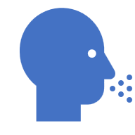

PROBLEM & PURPOSE STATEMENTS
Problem Statement:
Diagnosis and treatment planning involves human interpretation.
Mixed interpretation of medical records and speech complicates management.
Existing systems rely on paper-based procedures.
Paper-based systems negatively affect care decisions.
Purpose Statement:
Utilize advanced technologies to simplify healthcare diagnostics and treatment.
Apply NLP and DL to enhance diagnostic and treatment processes.
Notes:
The healthcare faces unsuccessful data use and manual interpretation causing diagnostic delays, errors, and rising costs that impact all stakeholders. (Stark et al., 2018; Heys et al., 2022) shared that the patients experience delayed treatment and poor outcomes while healthcare workers face burnout from data overload
Our automated tools will analyze medical text and audio, integrate data sources, and streamline diagnosis processes to deliver more accurate diagnoses, faster treatments, lower costs, and improved patient care with better resource utilization.

Slide 4
RESEARCH QUESTIONS & HYPOTHESES
RQ1: How effective is NLP in classifying patient symptoms from text data on the population level?
H1o: Text analysis of patient symptoms results in insufficient precision and recall for provider decision support.
H1a: Text analysis of patient symptoms results in precision and recall sufficient for provider decision support.
RQ2: How effective is NLP in classifying patient symptoms from audio data on the population level?
H2o: Audio analysis of patient symptoms yields both precision and recall metrics that are insufficient for effective provider decision support.
H2a: Audio analysis of patient symptoms results in precision and recall sufficient for provider decision support.
RQ3: How effective is NLP in classifying patient symptoms from audio and text data on the population level?
H3o: Audio and text analysis of patient symptoms yields both precision and recall metrics that are insufficient for effective provider decision support.
H3a: Audio and text analysis of patient symptoms results in precision and recall sufficient for provider decision support.
Notes:
This study has three main questions.
First, can NLP technology correctly identify patient symptoms from written notes?
Second, can it identify symptoms from voice recordings?
Third, can NLP technology correctly identify patient symptoms from written notes, and can it identify symptoms from voice recordings?
For the first question, we think text analysis will be accurate enough to help doctors make better decisions under the alternative hypotheses (H1a), though we start by testing whether it might not be sufficient under the null hypotheses (H1o).
For the second question, we test if audio analysis might not be precise enough for doctors under the null hypotheses (H2o). We test if audio analysis will be precise enough for doctors under the alternative hypotheses (H1a).
For the third question, we think text and audio analysis will be accurate enough to help doctors make better decisions under the alternative hypotheses (H3a), though we start by testing whether it might not be sufficient under the null hypotheses (H3o).

Slide 5
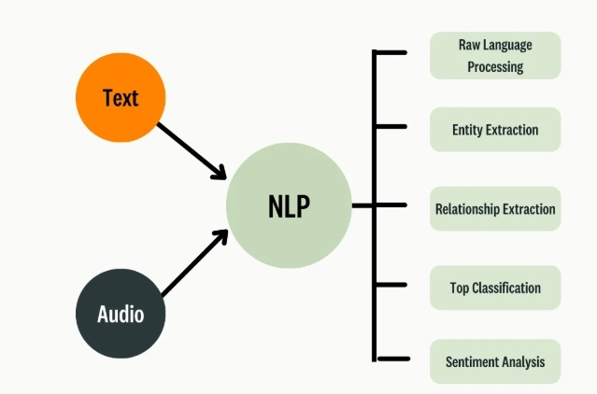
CONCEPTUAL FRAMEWORK
NLP and DL Integration Framework
Disease Classification Process
Text and Audio Analysis Components
Healthcare Implementation Model
Notes:
A constructive research design was chosen because it aligns with the study's goal of developing practical NLP and DL models for healthcare diagnostics.
The AI system processes patient data by extracting key details that help identify specific diseases. For text, the computer learns word meanings, while for audio, it analyzes sound patterns.

Slide 6
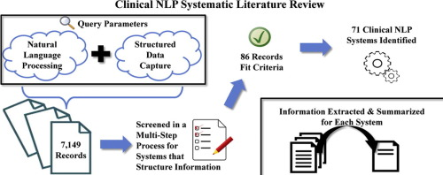
Notes:
Doctors always make mistakes during patient visits because they don't have sufficient technology to diagnose patients. Current systems are slow and make it hard to understand patient information. If we use standard diagnostic methods and add AI technology that can read text and understand voice recordings, doctors can make better diagnoses.

Slide 7
REVIEW OF THE LITERATURE
Major studies/sections:
Poor diagnosis prevalence (5% error rate in adult primary care)
Impact of technological limitations on healthcare
Need for standardization of diagnostic processes
Integration of NLP and DL in healthcare settings
Notes:
About 5% of doctor visits result in incorrect diagnoses. This happens because current technology is not sufficiently advanced to help doctors analyze patient information quickly and accurately. Doctors find it hard to manage all the patient notes and voice recordings. We need standard ways for all doctors to diagnose problems. New AI technologies, such as NLP and DL, can help by automatically reading patient notes and listening to recordings.

Slide 8
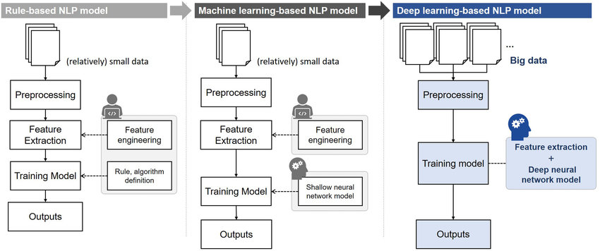
RESEARCH METHODOLOGY & DESIGN
Notes:
We analyze both written notes and patient voice recordings using DL and ML algorithms. We chose this method because it can solve real problems in healthcare and can be tested with specific numbers to demonstrate its effectiveness. The study helps doctors by automatically processing patient information that would take too long to review manually. The AI system cleans up the text by removing unnecessary words and symbols, then uses AI to find patterns that help identify diseases. They measure how well the system works by checking if it correctly identifies patients' conditions. This technology could help doctors make fewer mistakes and provide better treatment.

Slide 9
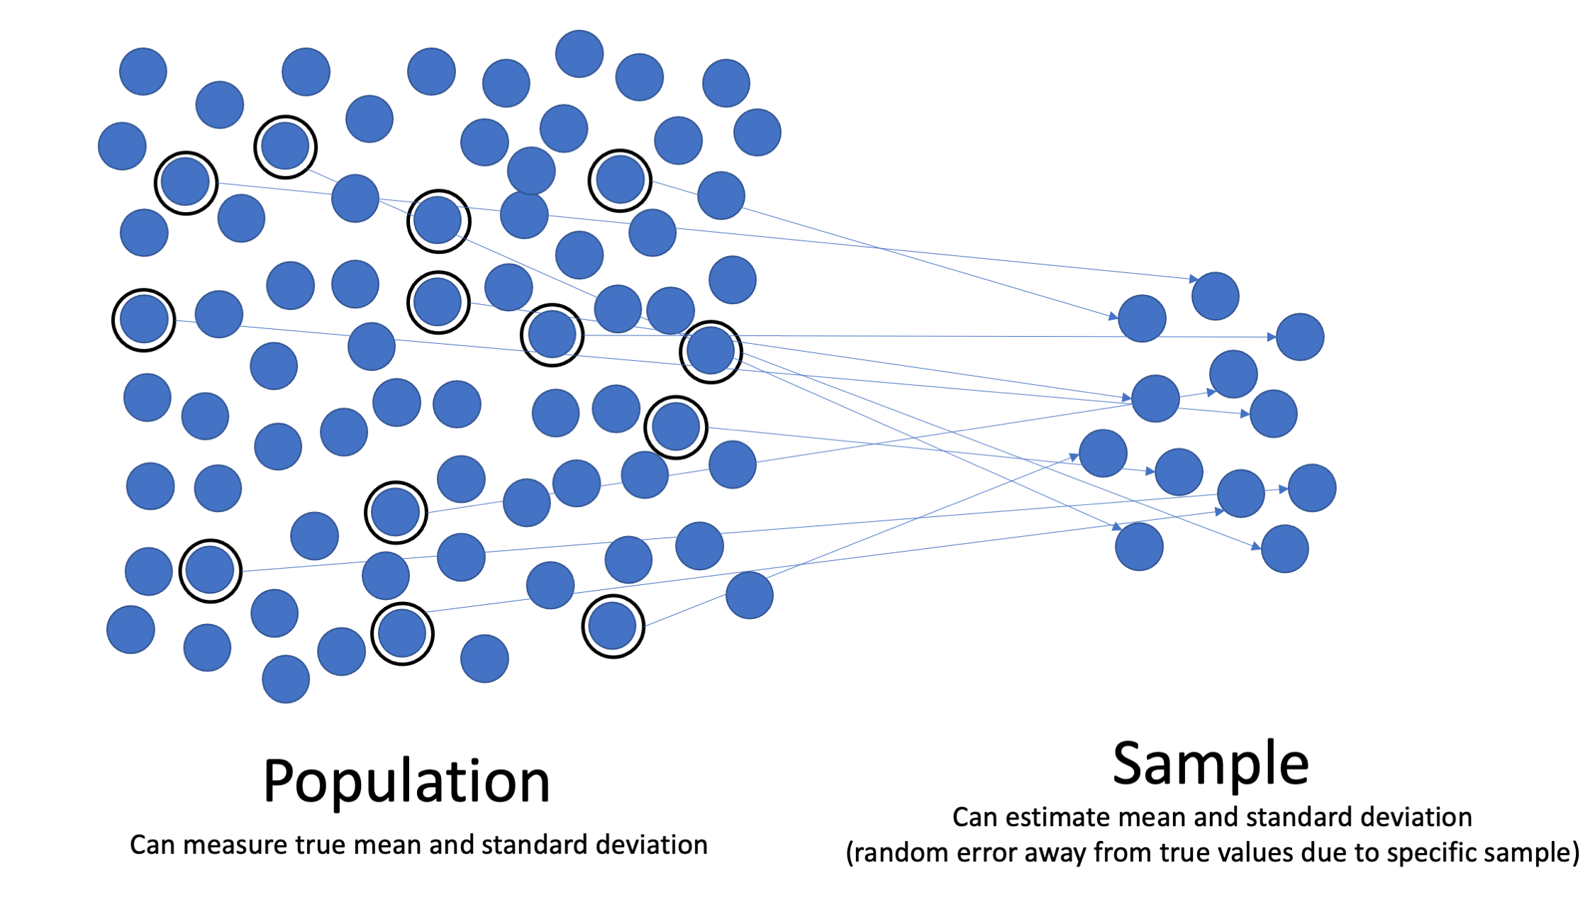
POPULATION & SAMPLE
Population Description:
Adult patients (18-65) approximately 7,221 with chronic diseases in primary care.
Appropriateness of the Population:
Relevant for studying diagnostic accuracy in chronic disease management.
Sample Description:
370 patients selected via stratified random sampling.
Inclusion Criteria:
Patients aged 18-65 with chronic diseases and 3+ follow-up visits.
Sampling Guidelines:
Randomly selected within strata (age, gender, disease type).
Power Analysis:
Sample of 370 ensures 0.80 power at 0.05 significance.
Recruitment Efforts:
Patients recruited via providers, flyers, and consent forms.
Notes:
This study examined patients who were sick at a hospital in Washington, DC. There were about 7,221 patients of different ages - young, middle-aged, and older people. We selected a public dataset of 370 patient records from Kaggle. The Kaggle dataset was selected because it contained structured and labeled audio and text data. The data is publicly available to everyone, ensuring that no Personally Identifiable Information (PII) was included. These records included both written notes and voice recordings. We randomly selected patients to avoid bias and used a special calculator to ensure 370 patients were sufficient for reliable results. The calculator showed that this number would yield 95% reliable results with only a 5% chance of error.

Slide 10
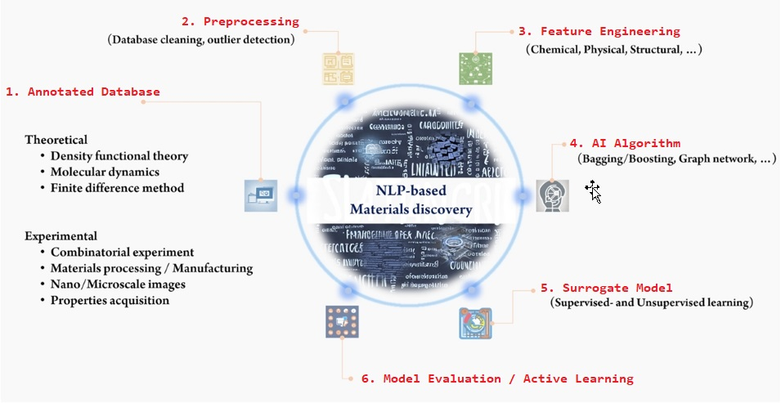
MATERIALS & INSTRUMENTATION
Notes:
This study used two AI tools to help doctors diagnose patients more effectively. The first is the NLP Toolkit, which reads patient notes, and the second is the DL Audio Classifier, which analyzes patient voice recordings. The DL algorithms chosen are Convolutional Neural Network (CNN) and Feedforward Neural Network (FNN), and the ML algorithms chosen are Logistic Regression, Naive Bayes, Random Forest, and Support Vector Machine, which analyze medical information by finding important patterns in words and sounds.

Slide 11
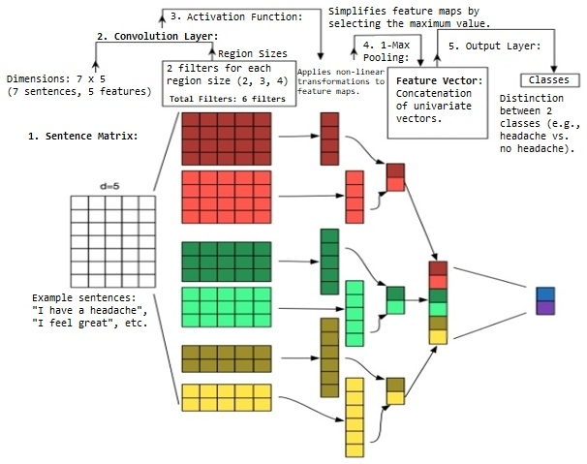
OPERATIONAL DEFINITIONS OF VARIABLES
Notes:
This study examines how AI tools can help doctors make accurate diagnoses. It uses two main types of information: written notes (Text Data) and patient voice recordings (Audio Data) to predict diseases. The study measures how accurate these predictions are compared with expert diagnoses (Diagnostic Accuracy). We consider patient information such as age and gender, as well as where patients received care (hospital or clinic). Accuracy is measured as a percentage (0-100%) showing how often the NLP and DL correctly identify diseases. The study combines results from both text and audio analysis to get a complete picture of how well these AI computing works.

Slide 12
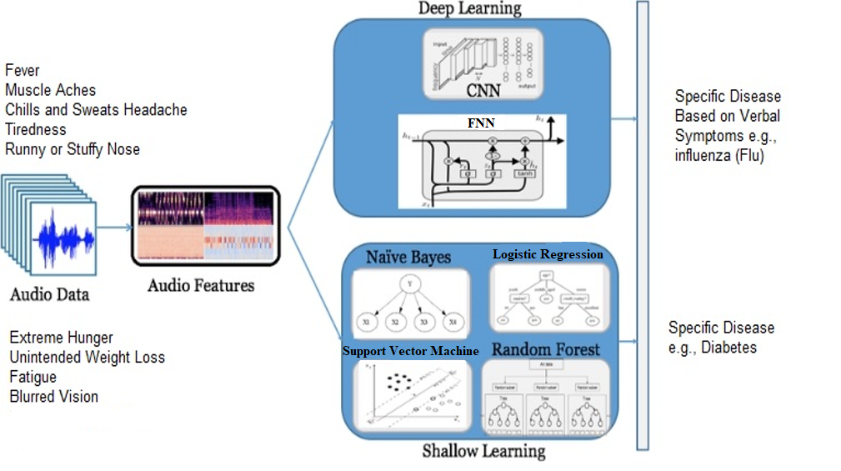
STUDY PROCEDURES
Systematic literature review process:
Database selection
Search key identification
Data collection
Analysis implementation
Results validation
Notes:
The first step in this research involved obtaining Institutional Review Board (IRB) approval to guarantee adherence to ethical standards in data usage. This included ensuring compliance with data protection regulations, such as HIPAA, to protect patient privacy. Then we worked with hospitals to collect patient records and voice recordings from the last five years. We cleaned this information by removing unnecessary words from text and improving audio quality. Next, we used two special AI computing: one is NLP to read patient notes, and another is DL to analyze voice recordings. We measured how well these computing identified diseases by checking accuracy, precision, recall, and F1-scores. Finally, we compared the machine learning algorithms results with diagnoses from real doctors to see if the technology worked correctly.

Slide 13
Data Selection And Collection
DATA ANALYSIS
Preprocess the Data
Text Cleaning
Audio Feature Extraction (MFCCs)
Handle Missing Values/Outliers
Training Set (70%)
Multimodal: Feature Concatenation
Data Split
Audio: MFCC extraction (13 coefficients + statistics)
Text: TF-IDF Vectorization (max 128 features)
Feature Engineering
Validation Set (15%)
Final Test Set Evaluation
Test Set (15%)
Traditional ML Models
Confusion Matrix
Per-Class Analysis
Model Training & Selection
Model Evaluation
Test and Predict
Validation Performance
Deep Learning Models
Performance Metrics (Accuracy, Precision, Recall, F1)
Notes:
Data Analysis Steps
In the data analysis phase, the process begins with data selection and collection, followed by thorough preprocessing, including text cleaning and MFCC-based audio feature extraction. The data is then split into training (70%), validation (15%), and test (15%) sets. A multimodal approach combines these features to effectively train models using both traditional machine learning and deep learning. After training, models are evaluated using metrics such as accuracy, precision, and recall, followed by a confusion matrix and per-class analysis to identify specific performance areas.

Slide 14
Research Questions
RQ1: How effective is the NLP algorithm in classifying patient symptoms from text data on the population level?
RQ2: How effective is the NLP algorithm in classifying patient symptoms from audio data at the population level?
RQ3: How effective is NLP in classifying patient symptoms from combining audio and text data on the population level?
Notes:
In this study, we explored the potential of DL in diagnosing and treating patients. Specifically, we address three key research questions: RQ1 investigates the effectiveness of NLP algorithms in classifying patient symptoms from text data at the population level, while RQ2 examines the usefulness of using NLP for classifying patient symptoms from audio data, and RQ3 investigates the effectiveness of NLP algorithms in classifying patient symptoms from text and audio data at the population level.

Slide 15
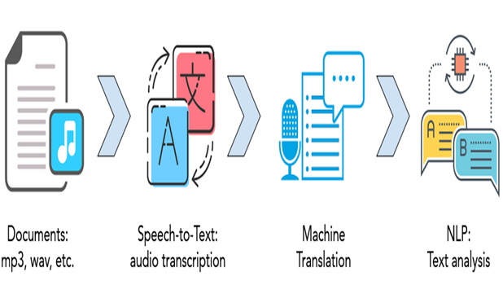
Exploratory Analysis Findings
Data Characteristics
Data Quality Assessment
Feature Engineering:
Notes:
Data Characteristics:
The dataset comprised 5,385 training observations (text and audio) and 385 test observations.
Key attributes included audio quality, speaker identification, and textual phrases.
Data Quality Assessment:
Audio quality ratings ranged from 2.5 to 5.0, with most ratings clustering around 3.75.
Textual data showed a balanced distribution of symptoms, essential for effective classification.
Feature Engineering:
Techniques such as tokenization, stop word removal, and feature interaction were employed to enhance model performance.
Mel-Frequency Cepstral Coefficients (MFCC) were used for audio feature extraction.

Slide 16
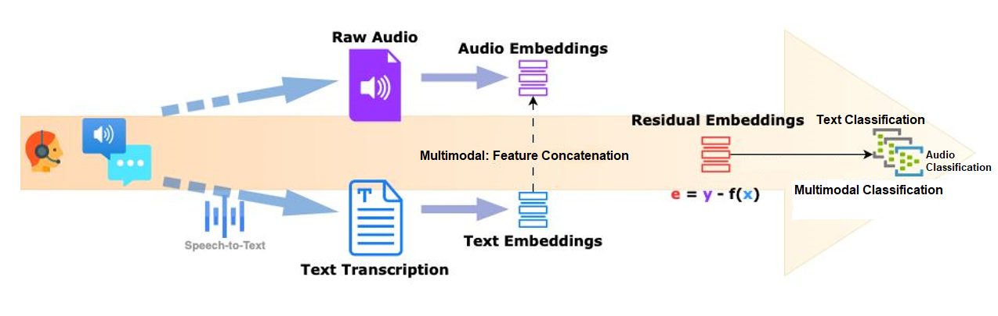
Detailed Results from Experiments (Text Classification)
Notes:
Text Model Results
The Logistic Regression model for NLP text classification achieved an accuracy of 91.79%, with precision and recall of 92.16% and 91.79%, respectively.

Slide 17
Detailed Results from Experiments (Audio Classification)
Notes:
Audio Model Results
The analysis of audio processing for classifying patient symptoms from audio data presents significant challenges, with the best model, Logistic Regression, achieving 8.13% accuracy, 8.45% precision, and 7.33% F1-Score.

Slide 18
Detailed Results from Experiments (Multimodal Classification)
Notes:
Text and Audio Model Results
The evaluation of the audio-text fusion model utilizing a CNN achieved 83.65% accuracy, 85.34% precision, 83.65% recall, and an F1-score of 83.85%.

Slide 19
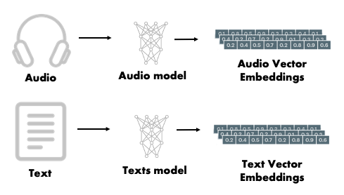
Embeddings and Their Impact
Embeddings Utilized
Impact on Model Performance
Notes:
Embeddings Used
For text data, TF-IDF embeddings were used to capture the importance of terms within documents. For audio data, MFCC (Mel-Frequency Cepstral Coefficients) were employed to effectively classify sounds.
Impact on Model
The integration of these embeddings improved the models' ability to handle new data, resulting in enhanced accuracy and reliability. Additionally, they facilitated a deeper understanding of the data, which is essential for accurate symptom classification.

Slide 20
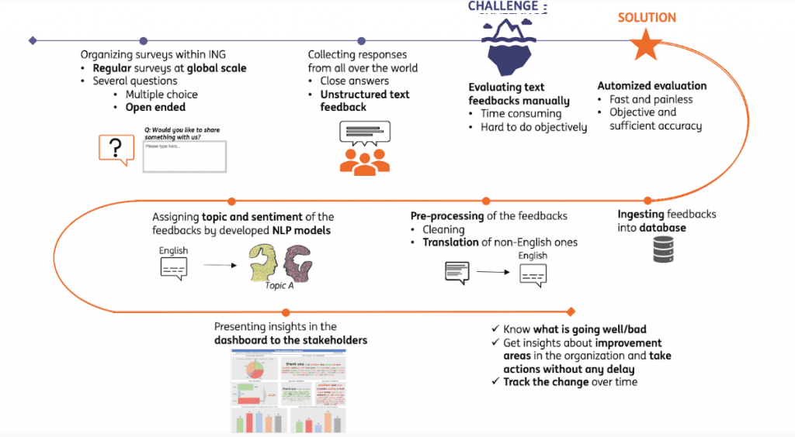
Model Development and Performance
Notes:
Various machine learning algorithms were evaluated for their effectiveness in classification tasks, including Logistic Regression, Feedforward Neural Network (FNN), Random Forest, Support Vector Machine (SVM), Convolutional Neural Network (CNN), and Naive Bayes. The results showed that Logistic Regression and FNN demonstrated strong performance in text classification, with accuracies of 94.34% and 93.27%, respectively. However, audio classification accuracies were notably lower, with the best achieving only 8.29% for Logistic Regression.
The CRISP-DM framework was employed for systematic model deployment, facilitating real-time analysis and integration into clinical workflows. This structured approach enabled effective incorporation of feedback, ultimately enhancing model performance and usability in practical applications.

Slide 21
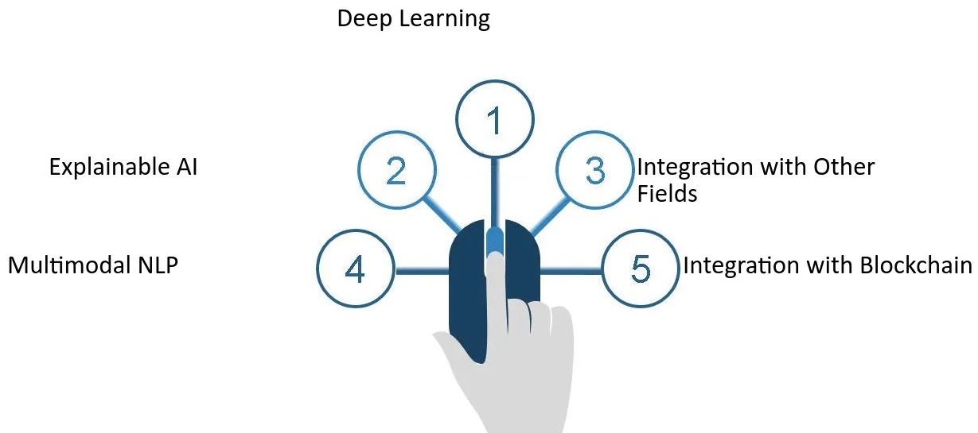
Conclusion and Future Directions
Key Findings
Future Research Directions
Notes:
Key findings: The study showed that NLP and DL methods work well for classifying patient symptoms from text and audio. High accuracy suggests these technologies can improve healthcare diagnosis.
Future Research: Explore combining text, audio, and other data (like images) for better diagnostics. Improve models to make them easier to understand and address ethical issues in AI healthcare.

Slide 22
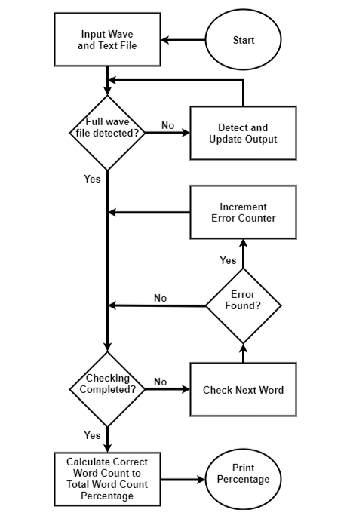
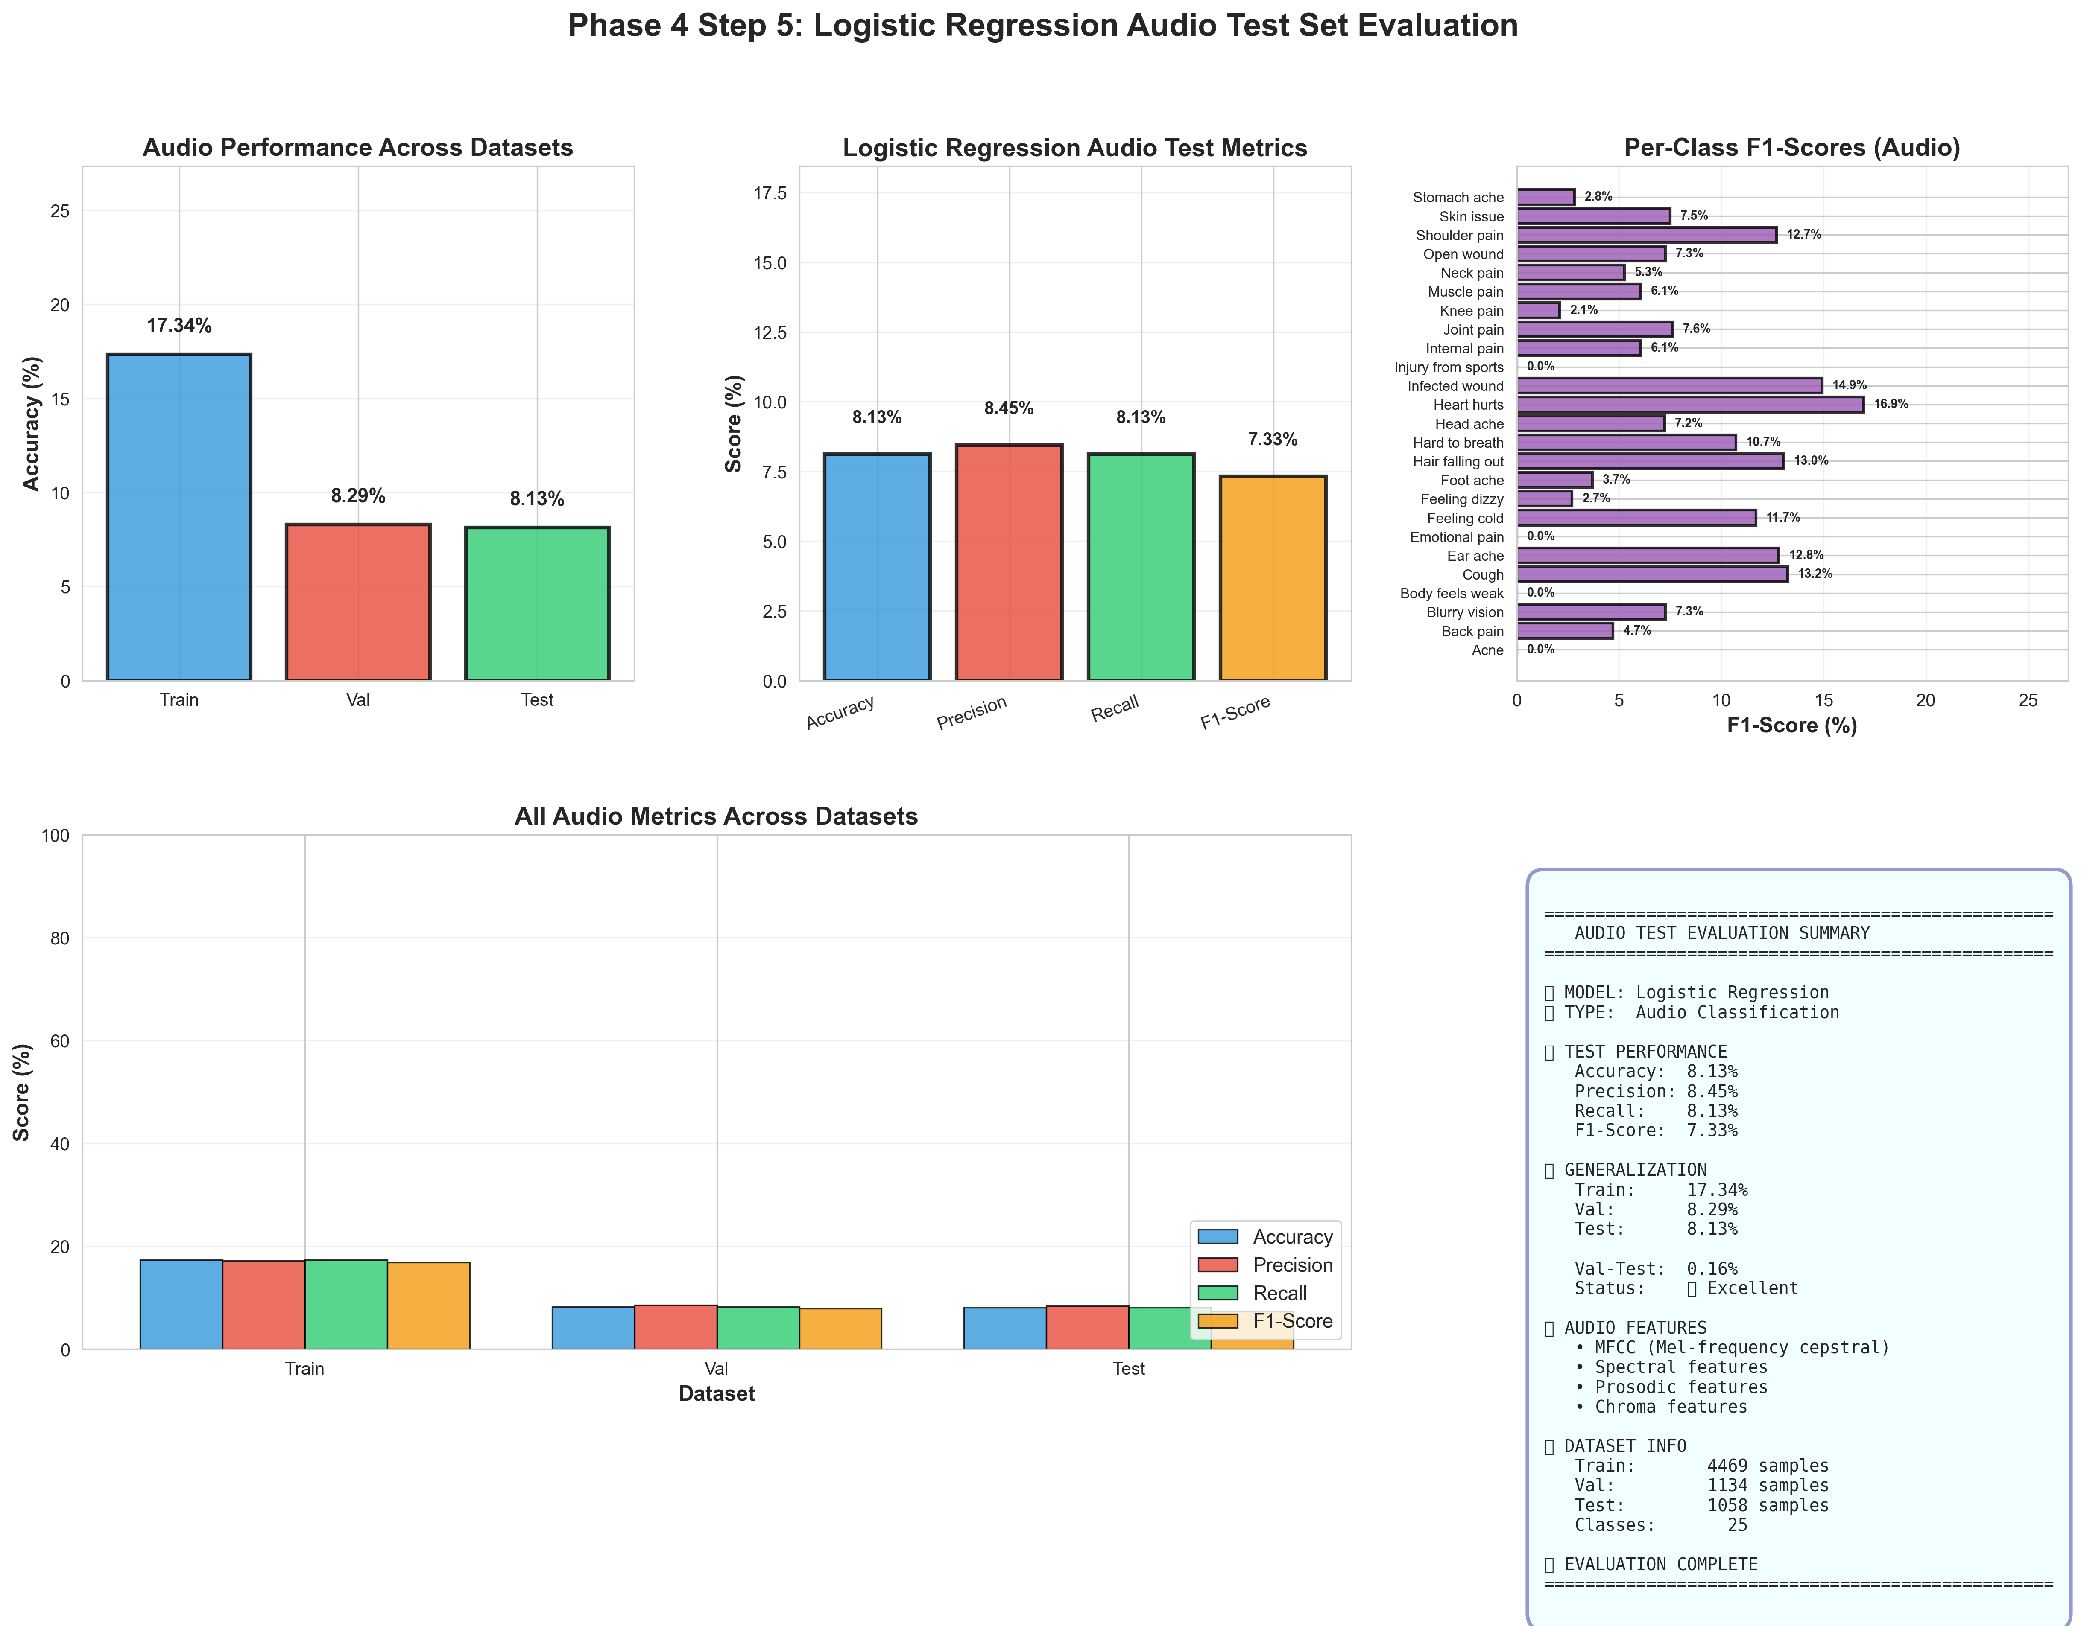
Audio RESULTS Interpretation
Notes:
Audio Results Interpretation
The Logistic Regression model showed significant challenges in audio classification. It achieved an accuracy of 8.13% on the test dataset, alongside precision and recall scores of 8.45% and 8.13%, respectively, resulting in an F1 score of 7.33%. The model performed best on the training data, with an accuracy of 17.34%, but this was not replicated in the validation and test sets, suggesting potential overfitting.
Per-class F1-Scores indicated variability, with scores as low as 2.8% for stomach aches and 5.3% for shoulder issues. This variability underscores the need for further model refinement to enhance clinical decision support. The audio features utilized included MFCC, spectral attributes, prosodic features, and chroma attributes, contributing to a multimodal classification strategy.

Slide 23
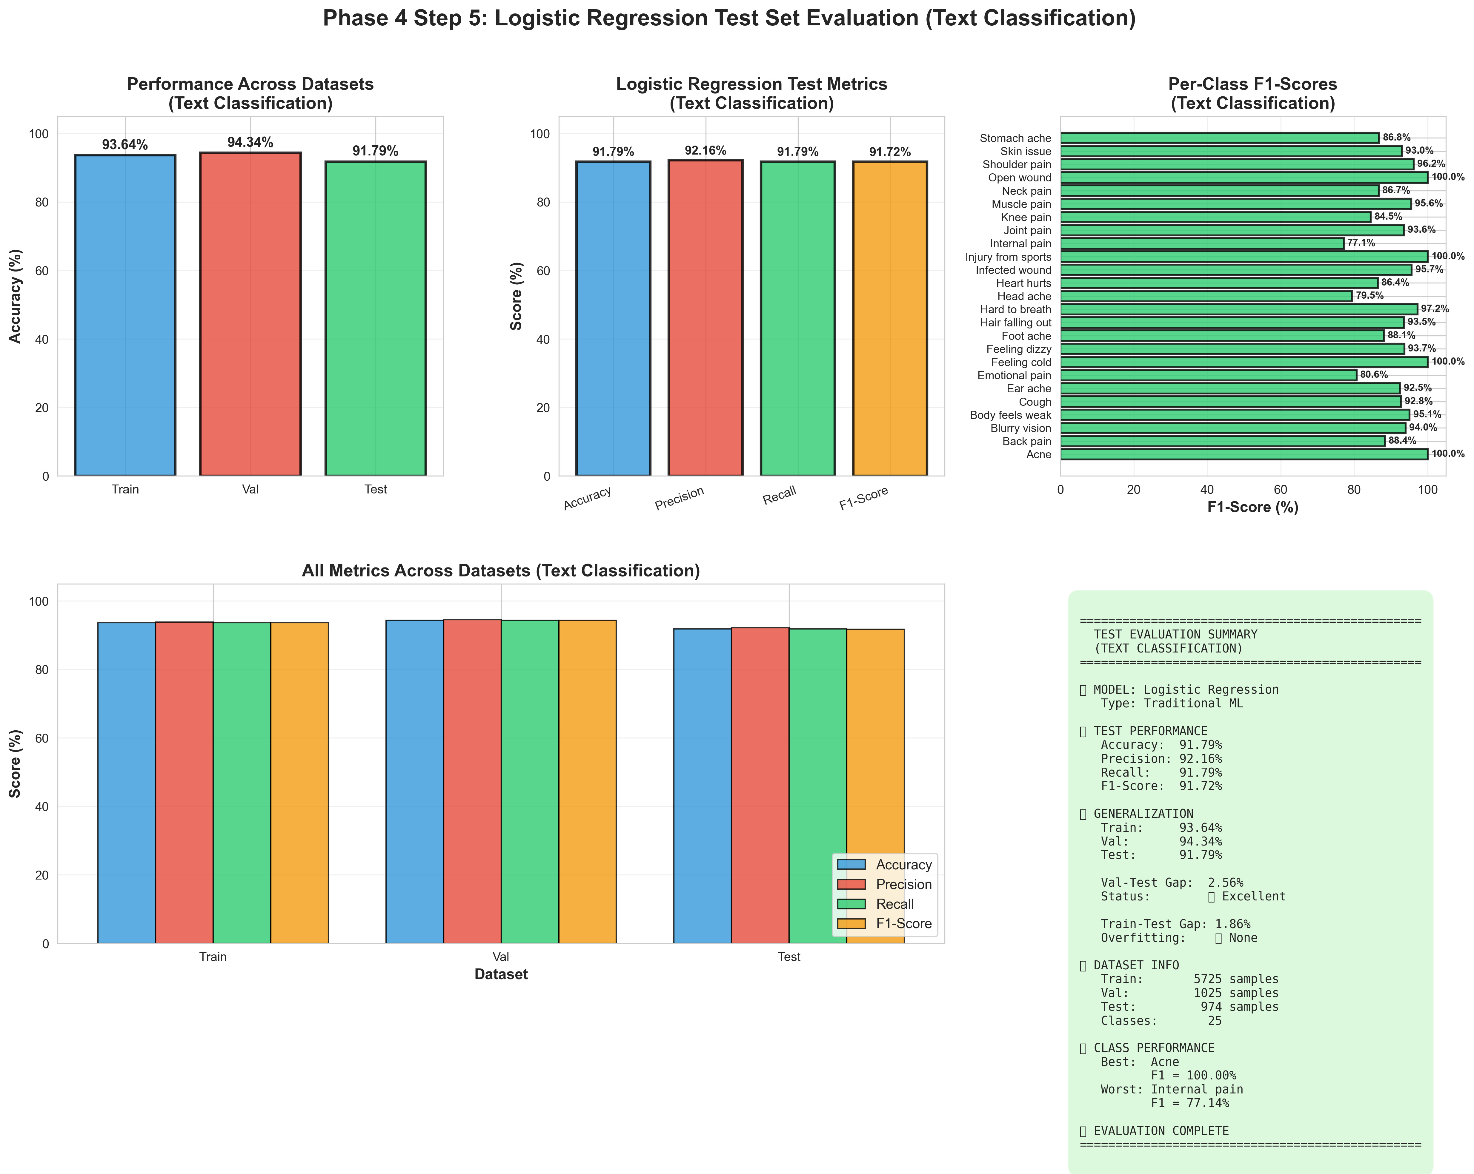
Text RESULTS Interpretation
Notes:
Text Results Interpretation
The Logistic Regression model demonstrated excellent performance in text classification, achieving an accuracy of 91.79% on the test dataset. The model also achieved a precision of 92.16% and a recall of 91.79%, resulting in an F1-score of 91.72%. Consistency across datasets was observed, with training and validation accuracies of 93.64% and 94.34%, respectively, indicating effective generalization. The per-class analysis revealed optimal performance for certain symptoms, with F1-Scores as high as 100% for conditions such as "cough" and "skin issue,” while "internal pain" had the lowest score of 17.74%. This indicates areas for potential improvement in model training.

Slide 24
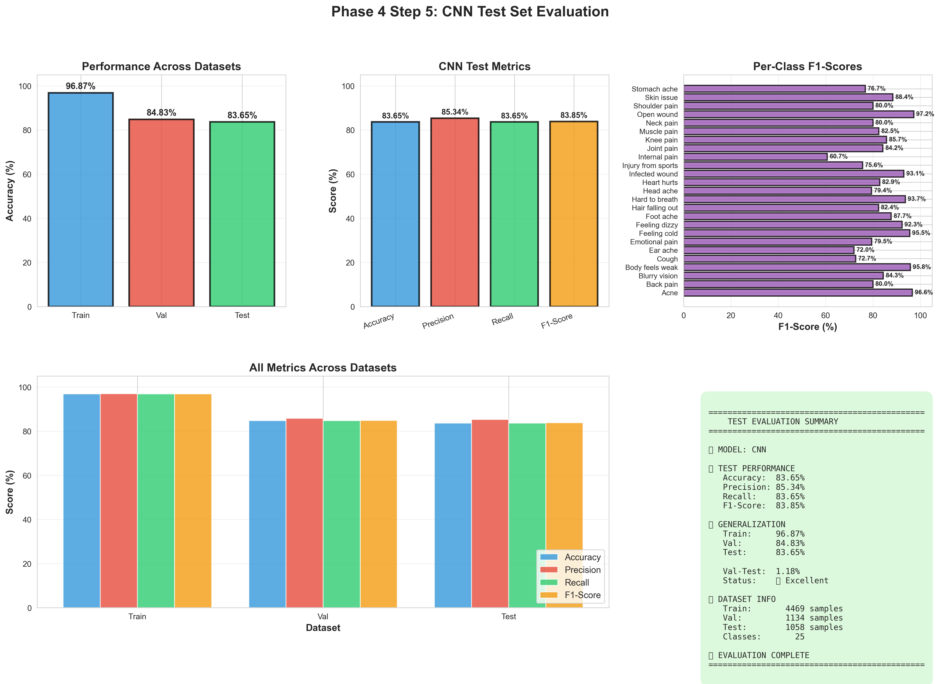
Audio and Text RESULTS Interpretation
Notes:
Audio and Text Results Interpretation
The CNN model demonstrated strong performance in both audio and text classification tasks. For audio classification, it achieved an accuracy of 83.65% on the test dataset, with precision and recall scores of 85.34% and 83.65%, respectively, resulting in an F1-Score of 83.85%. Notably, symptoms like “stomach ache” and “skin issue” scored exceptionally well with F1-Scores above 80%. In text classification, the model showcased impressive accuracy at 83.65%, with similar precision and recall metrics, indicating excellent generalization across the validation and test datasets. Overall, both tasks reveal solid performance, highlighting areas for further improvement in less recognized symptoms.

Slide 25
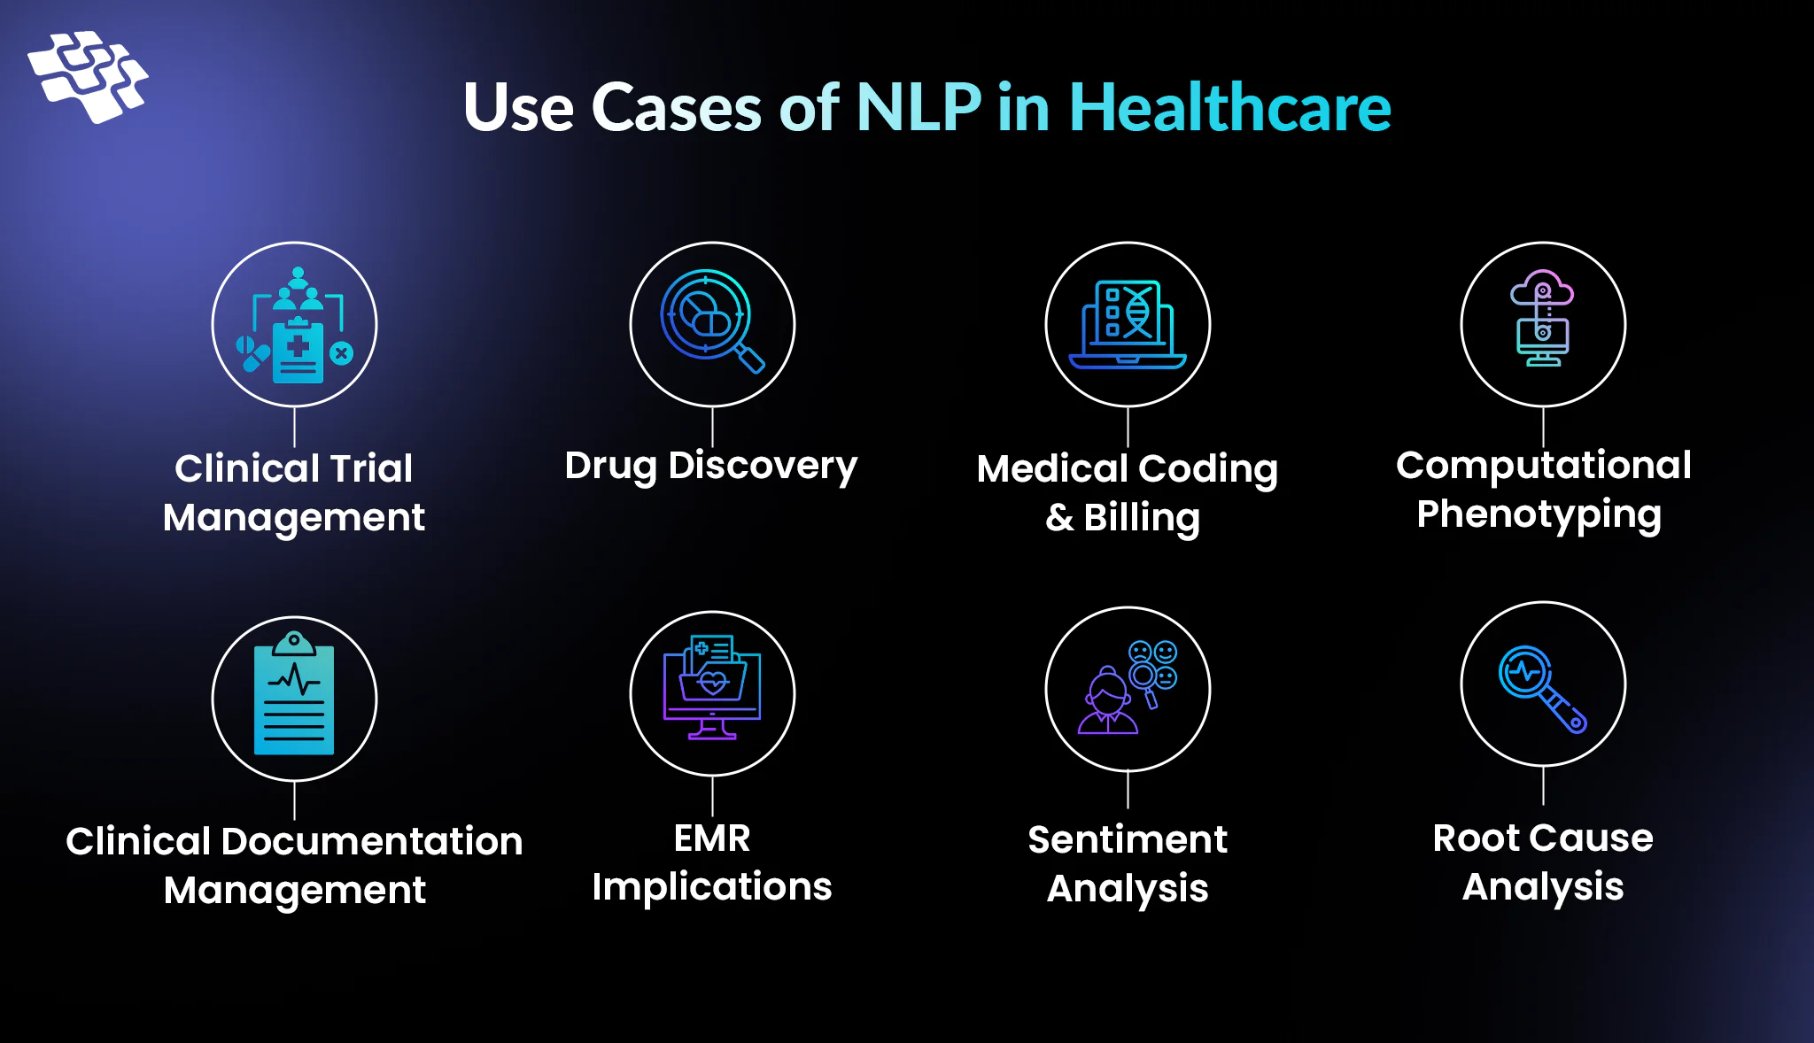
IMPLICATIONS
Notes:
The study showed these programs are accurate enough to be useful in hospitals and clinics. Some things affected the results, like the quality of patient data used to train the computer and differences in how people describe their symptoms. The findings match what other researchers have found - that these AI tools can help with medical diagnosis. However, there were some differences when compared to other studies, possibly because of different research methods or patient groups. More research is still needed to better understand how these AI tools can help doctors in different situations. Overall, hospitals should consider using these tools to improve patient care.

Slide 26
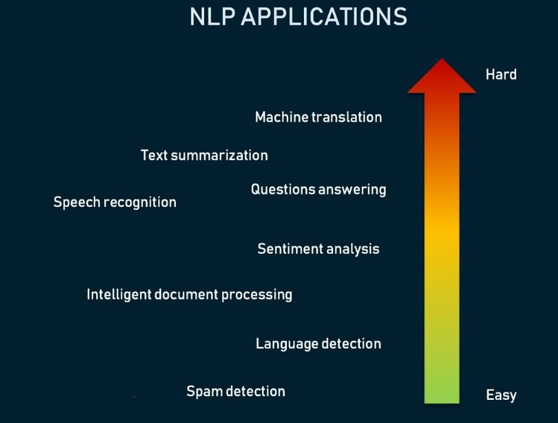
RECOMMENDATIONS (PRACTICAL APPLICATION)
Notes:
This study recommends three main actions based on its findings:
First, hospitals should use AI computing that can read patient notes to help doctors make diagnoses. These programs were 85% accurate in identifying symptoms.
Second, doctors and nurses need regular training to feel comfortable using these new AI powered tools. When healthcare workers understand the technology, they can use it better.
Third, hospitals should collect both written notes and voice recordings from patients because using both types of information leads to more accurate diagnoses. However, more research is needed before these tools can be used everywhere.
These recommendations can help improve healthcare by making diagnoses faster and more accurate, which means better treatment for patients.

Slide 27
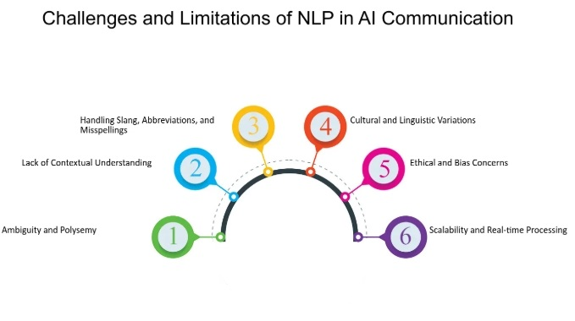
LIMITATIONS
Identified limitations:
Current data capture system limitations
Human interpretation variations
Technological constraints
Implementation challenges
Notes:
This study has some limitations:
To handle data quality issues… strict rules and cleaning steps were used.
To make the results more widely applicable… data from different sources were included.
While the study used a large amount of data… some groups might not be fully represented.
Finaly, technology limits were managed by using cloud tools and updated software. Possible biases were reduced with automated methods and cross-checking. Time limits prevented long-term analysis, which is recommended for future work. Ethical concerns about patient data were addressed by following IRB guidelines.

Slide 28
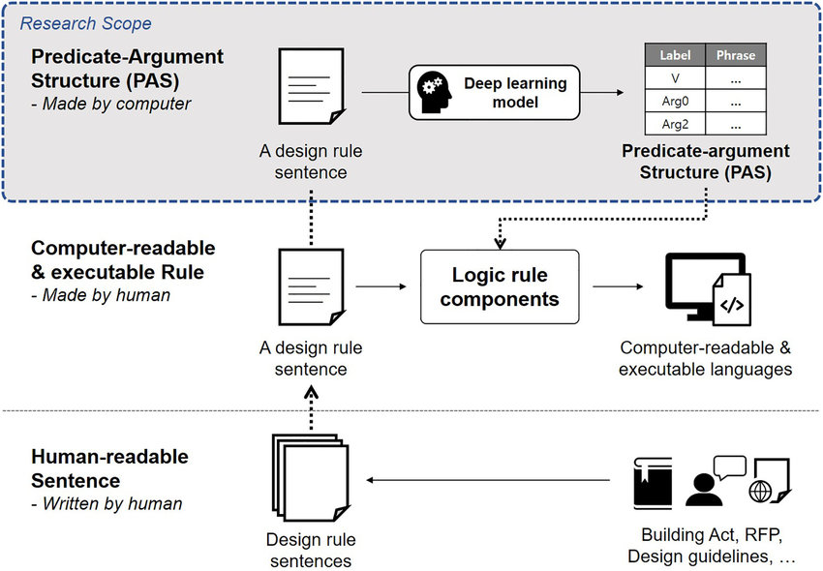
RECOMMENDATIONS (FUTURE RESEARCH)
Recommendation 1: Explore Diverse Populations.
Recommendation 2: Longitudinal Studies.
Recommendation 3: Integrate Advanced Machine Learning Techniques.
Notes:
For future research on AI powered tools that analyze patient textual data, and audio data the study recommend three important steps.
First, test these AI powered tools with many different types of patients (like different ages, backgrounds, and illnesses) to make sure they work well for everyone.
Second, study how these AI powered tools help patients over many months or years, not just present time. This will show if they really improve healthcare in the long run.
Third, try using newer and more advanced AI algorithms to make these tools even more accurate.
These recommendations will help make AI powered tools better at helping doctors diagnose patients correctly, which can improve healthcare for people who speak different languages or come from different cultures.
We envision the NLP and DL models can be integrated into Electronic Health Record (EHR) systems to assist healthcare providers in analyzing patient symptoms from text and audio data.
This would streamline the diagnostic process, reduce delays, and improve treatment accuracy. Additionally, the models can be used in telemedicine platforms to enhance remote patient monitoring and diagnosis.

Slide 29
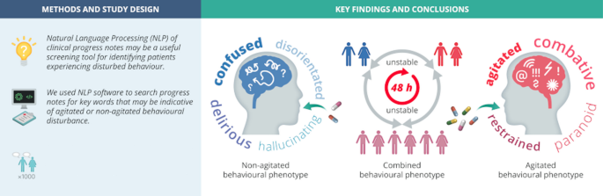
CONCLUSIONS
Overarching Conclusions
Connection to Framework and Literature
Main Message and Recommendations
Notes:
This study found that AI powered tools analyze patient textual data with NLP and audio data with DL can greatly improve how doctors diagnose health problems. The research shows these tools give fast and accurate results when identifying patient symptoms. This matches what other researchers have discovered about using AI in healthcare. The most important message is that these AI powered tools for patent diagnoses can make big improvements in how doctors diagnose patients. For the future, researchers should test these tools with many different types of patients, study how well they work over longer periods, and use newer built-in AI powered tools methods to make them even better as API (Application Programming Interface) is a set of rules and protocols that allows different software applications to communicate and exchange data. This research helps show that these technology tools should be used more widely in hospitals and clinics to improve patient care.

Slide 30
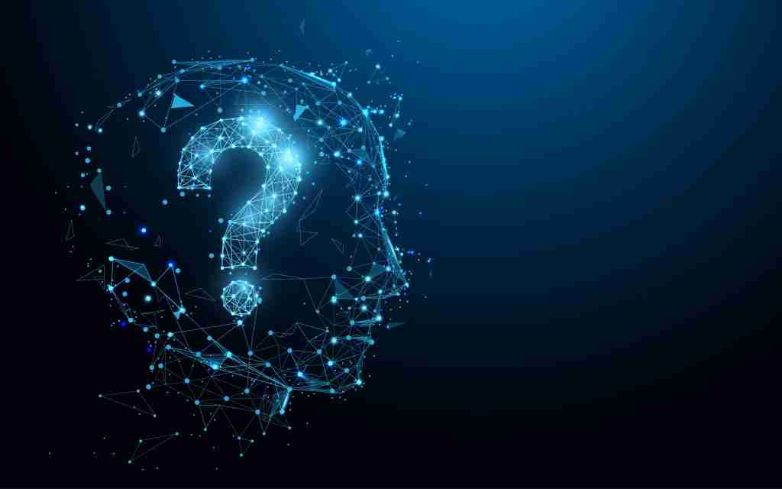
THANK YOU
Notes:
Thank you for your attention. Are there any questions?

Slide 31
Lu et al. (2020), which discusses the complexity of diagnosing and treating diseases using textual and auditory data
Heys et al. (2022), which critiques current data capture systems and their impact on care decisions
Kim & Lee (2021), presenting estimates on medical deaths due to errors in the U.S. healthcare system
Leary et al. (2021), emphasizing the need for proper diagnoses to ensure effective healthcare systems
Newman-Toker et al. (2020), analyzing the impact of diagnostic errors on patient mortality
Alturaiki et al. (2023), contributing to the conversation around health statistics and diagnostic reliability
REFERENCES

